Slide 1

Lego
Package
Recognition
COMP6206
Advanced
Computer
Vision
Yaopengfei Lyu 27921832
Li Sun 27536432
Zhenyu Chen 27520129
Lei Zhang 27678385

Slide 2
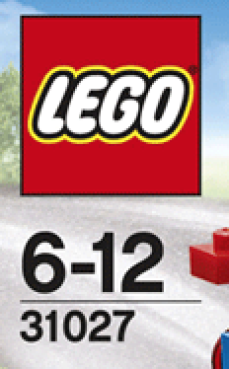
Flow Chart
Lego Logo Detection & Anti-distortion
Information Cropped
De-noise and Thresholding
Optical Character Recognition(OCR)
CNN Training Dataset
CNN Predict
Combine Result
Box Number Identified

Slide 3
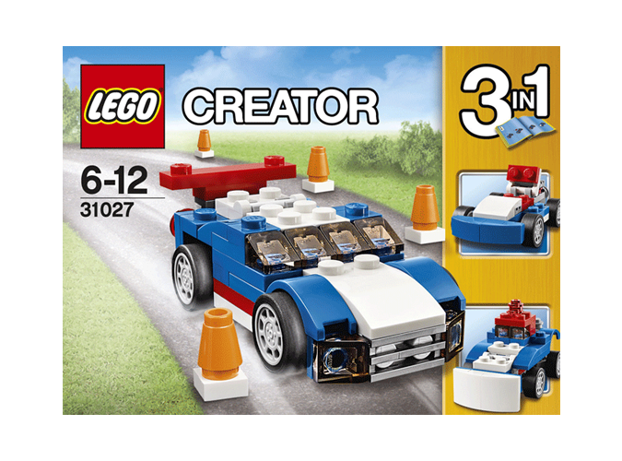
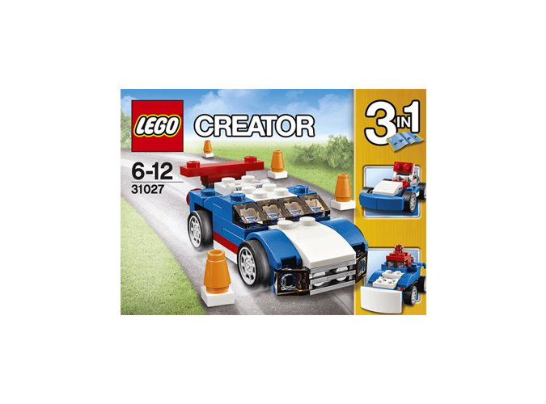
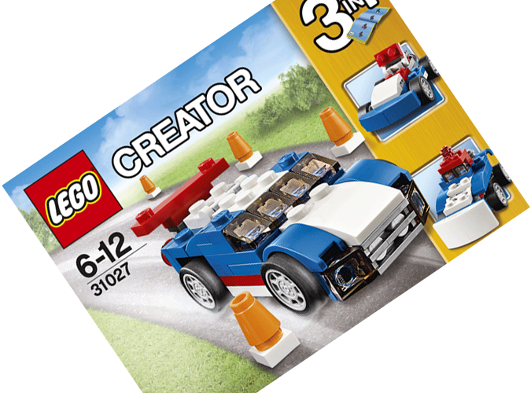
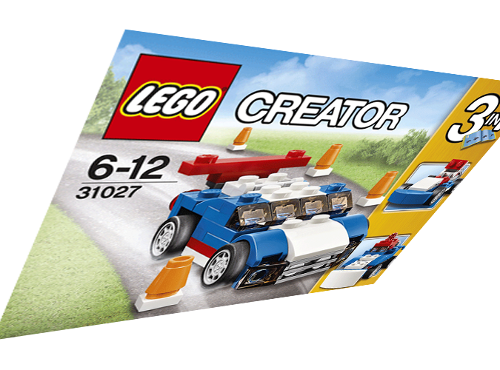
Image Preprocessing
Standard form
Scaling change
Rotation
Perspective transform
We use image preprocessing to detect the red logo, recover the shooting box to standard form from any shooting angle and extract the area of the number.
Number area is the area under the logo in the image.
Standard form was defined as the box surface parallel with the shooting camera and the texts are normal morphology in the image.
Notes:
Ok, thanks Li sun, I will simply explain the what’s the image preprocessing in our works.
Each box have a unique number, we are trying to use it to classify the box.

Slide 4
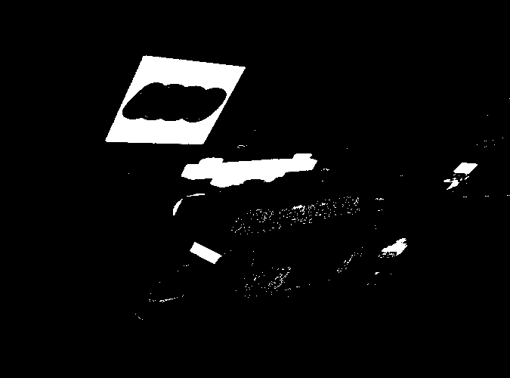
Image Preprocessing
Step1: Using HSV color space to find the red area in the image. The result is a mask.
Notes:
Ok ,I will show the image preprocessing workflow by a good sample. Remember it’s a good sample. Consists of 6 steps.
Because the logo is a red square. It will narrow down the search area.

Slide 5
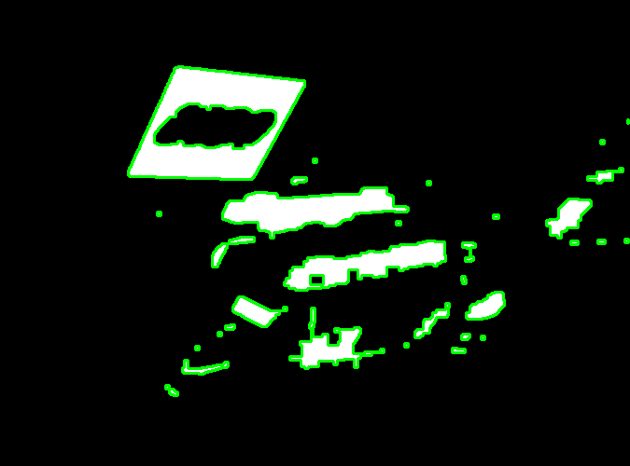
Image Preprocessing
Step 2: Finding all contours from the mask.
Notes:
Opencv provided a useful implementation, we just need to use it.

Slide 6
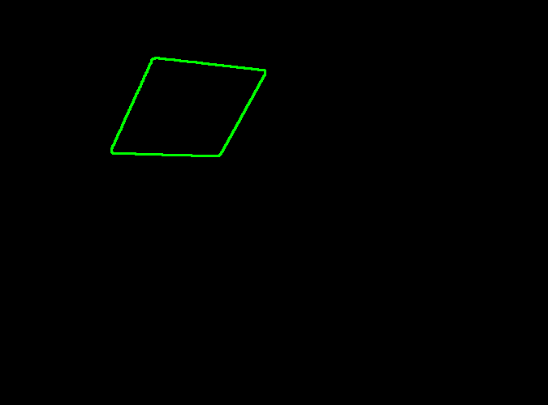
Image Preprocessing
Step 3: Picking the biggest quadrilateral from the contours by some geometric attribution.
Notes:
Using the image moments to calculate some geometric attribution(area, perimeter). I don’t really want to closely explain How to do that?

Slide 7
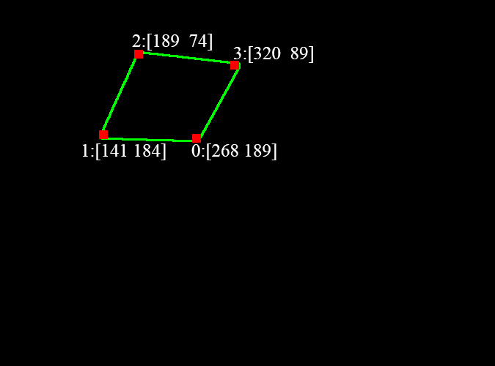
Image Preprocessing
Step 4: Detecting and sorting the four corners by Harris method. It could also verify the contour whether is a quadrilateral.
Notes:
Quadrilateral must have 4 corners, no more, no less. About sorting, we use some a small trick to make the points always be sorted clockwise.

Slide 8
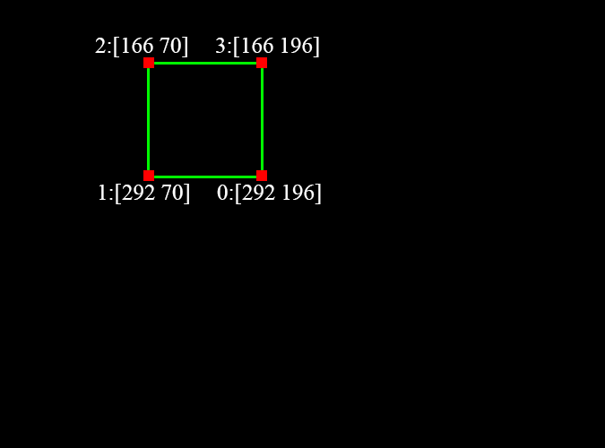
Image Preprocessing
Step 5: Creating a standard square preparing for affine transform.
Notes:
The length and location of this square determined by the quadrilateral we detected.

Slide 9
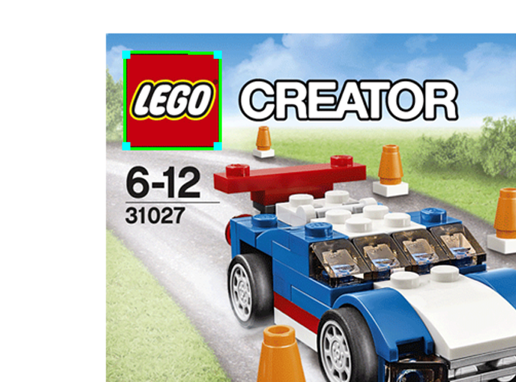
Image Preprocessing
Step 6: Calculating the transformation matrix(tM) by quadrilateral corners and standard square corners.
tM could be used to recover the tortile box.
Notes:
And we can get a good result now.

Slide 10
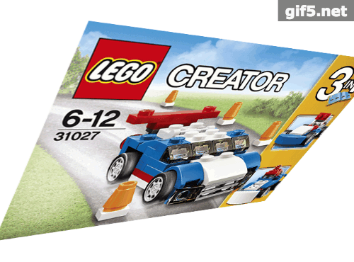
Image Preprocessing
Pick red area
Find contours
Pick quadrilateral contour
Find and sort 4 corners
Create standard square
Calculate tM & Recover image
Is that finish?
Notes:
Ok, let’s review key techniques. Is that finish? Of corse not, I said this is a good sample before. So if we have a bad sample, what will happen??

Slide 11
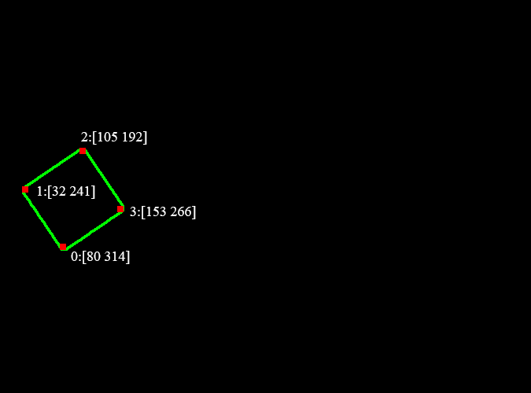
Image Preprocessing
Pick red area
Find contours
Pick quadrilateral contour
Find and sort 4 corners
Create standard square
Calculate tM & Recover image
Notes:
Now, In here, we choose the rotated box, The first 4 steps are same with the last image. But when we finding and sorting the 4 corners, did you see any difference?

Slide 12
Image Preprocessing
2
1
0
3
Pick red area
Find contours
Pick quadrilateral contour
Find and sort 4 corners
Create standard square
Calculate tM & Recover image
Notes:
Let’s mark these 4 points in the image.

Slide 13
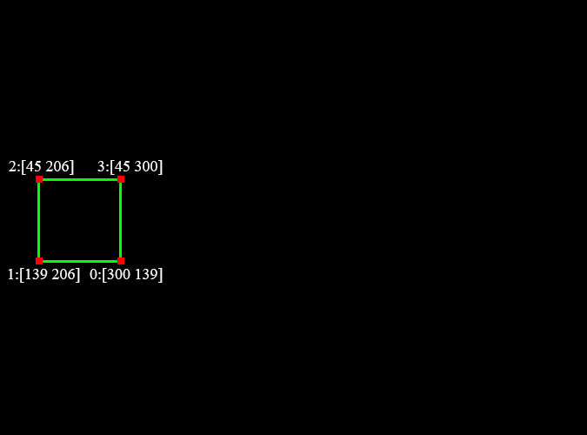
Image Preprocessing
2
1
0
3
Pick red area
Find contours
Pick quadrilateral contour
Find and sort 4 corners
Create standard square
Calculate tM & Recover image
Notes:
Next step, let’s create a square and mark the four corners of this square. What will happen if we use these eight corners to calculate the transformation matrix and recover the image?

Slide 14
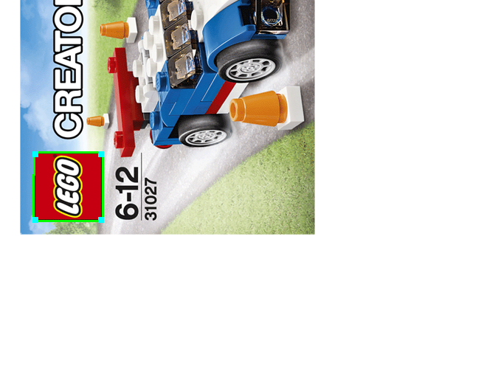
Image Preprocessing
2
1
0
3
Pick red area
Find contours
Pick quadrilateral contour
Find and sort 4 corners
Create standard square
Calculate tM & Recover image
Notes:
We will get a orthogonal result comparing with the standard form. Why that happen? Because we just know corner points are clockwise sorting, we don’t know the absolutely correct corners position. Got it? But anyway, we have a orthogonal result now.

Slide 15
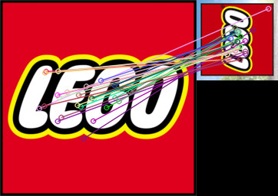
Image Preprocessing
Matching the feature points with the standard logo image
Estimating rotation angle by matched feature points
Rotation again
Notes:
How can we overcome this and get a correct result. We used feature points matching. We try to crop the vertical logo and matching the feature points with the standard logo image.

Slide 16
Image Preprocessing
Matching the feature points with the standard logo image
Estimating rotation angle by matched feature points
Rotation again
Notes:
Some people probably will ask, why don’t use the matching points to calculate the transformation matrix directly? Because the matching points are not always correct, many of these points are wrong matching. we can only use matching points to get a very roughly result It’s not accurate enough for transformation matrix. But if we add the previous result. we just need to judge these roughly result is 0, 90, 180, -90. Previous result is vertical or parallel with the correct result. So that’s why we do that.

Slide 17
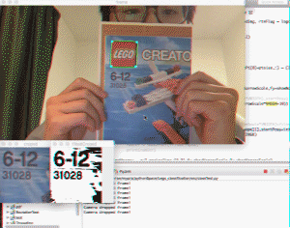

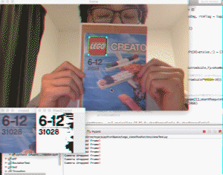
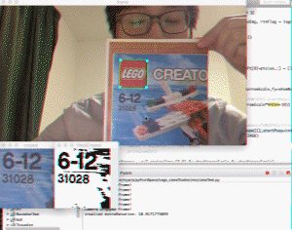
Image Preprocessing
Scaling
Rotation
Perspective
transform
Implementing result
Notes:
I will show a short video. You can see, This algorithm performed good. It could against the scaling rotation and perspective transform and recover the image to what we want. it does work

Slide 18
Image Preprocessing-denoise
Problems:
Sharpness;
Light;
Background;
Approaches:
Sharpness:
-De-convolution;
Normal:
-Thresholding;
Background:
-Heat Equation;
-Canny Edge Detector;
-Edge Connection;
-Area Filled Function;
Light: -Black and White Mask;

Slide 19
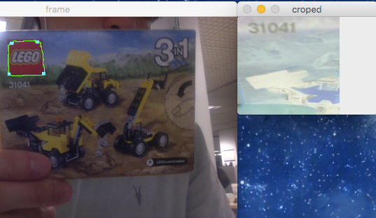
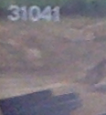
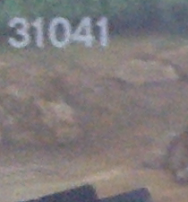
Image Preprocessing-denoise
Sharpness
Sharpness reflects how many details and how much acutance an image has. ( Clarkvision.com, 2016 )
Clarkvision.com. (2016). Clarkvision: Image Restoration 2 Using Adaptive Richardson-Lucy Deconvolution. [online] Available at: http://www.clarkvision.com/articles/image-restoration2/ [Accessed 26 May 2016].

Slide 20
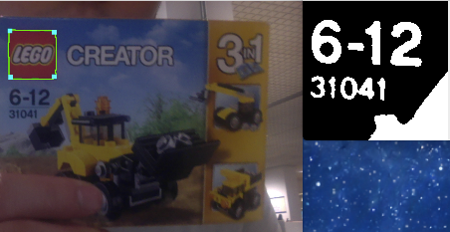
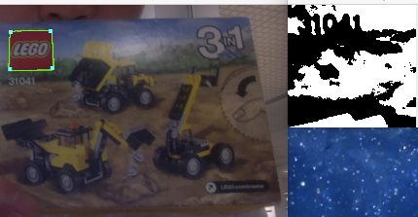
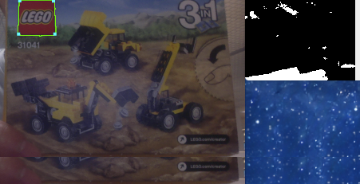
Image Preprocessing-denoise
Background
a. Good
b. Poor
c. Bad

Slide 21
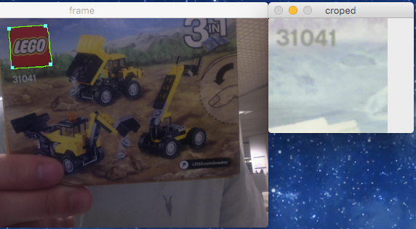
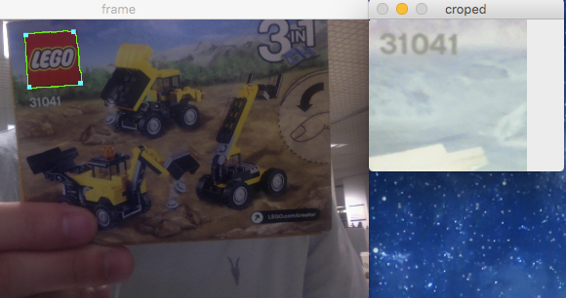
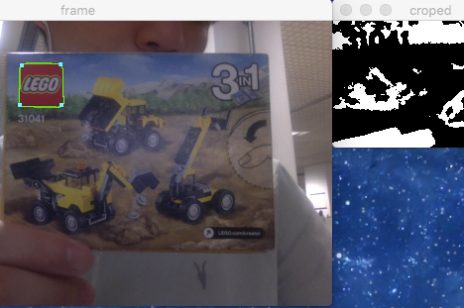
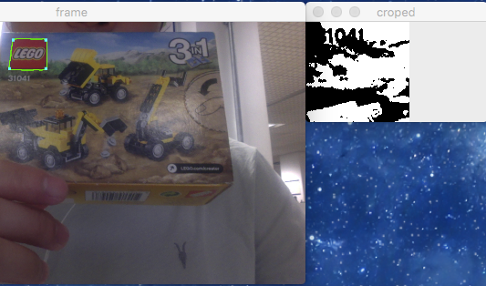
Image Preprocessing-denoise
Light

Slide 22
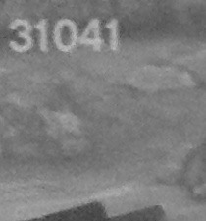
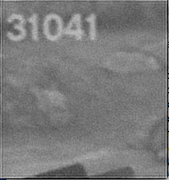
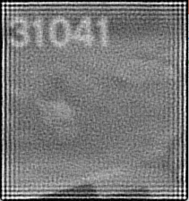

Image Preprocessing-denoise
De-convolution
a. origin
b. Sharper
c. Over Sharpness

Slide 23
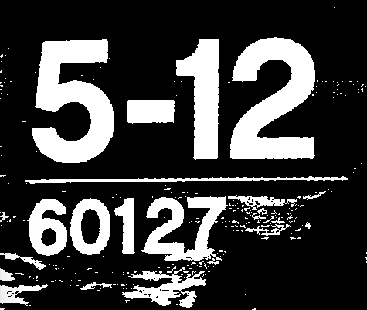
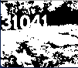
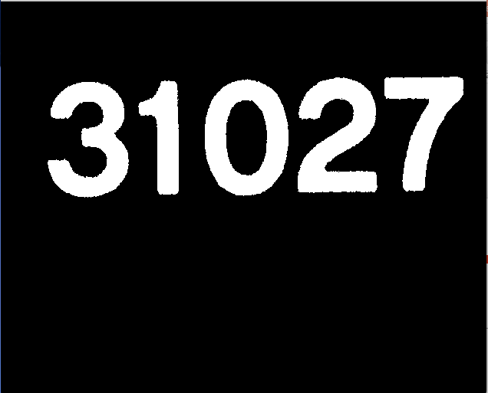
Image Preprocessing-denoise
Thresholding
a. Good
b. Bad
c. Optimal
Otsu Thresholding

Slide 24
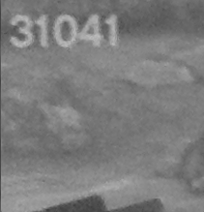
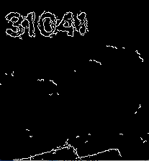
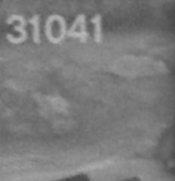
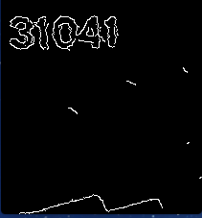

Image Preprocessing-denoise
Heat Equation
a. original
b. Edge
c. T=1/35, iteration=13
d. Edge

Slide 25
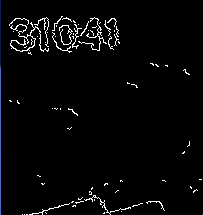
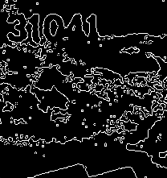
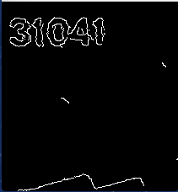
Image Preprocessing-denoise
Canny Edge Detector
a. Original
b. Thresholding
c. Heat-Equation

Slide 26
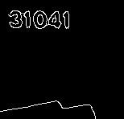
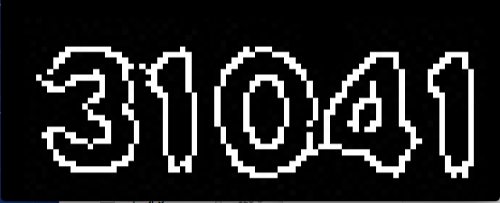
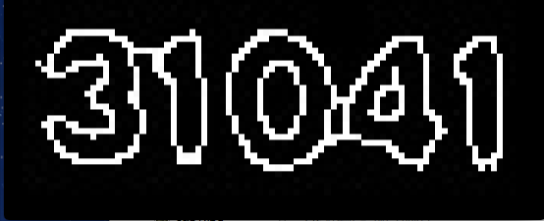
Image Preprocessing-denoise
Edge Connection

Slide 27

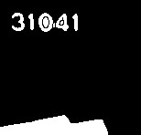
Image Preprocessing-denoise
Area Filled Function

Slide 28
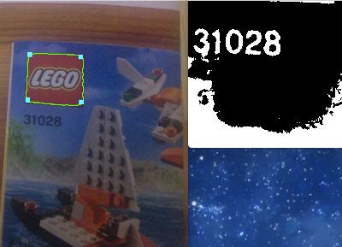
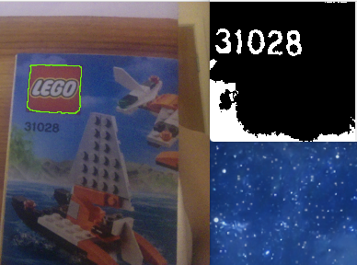
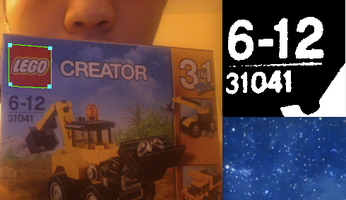
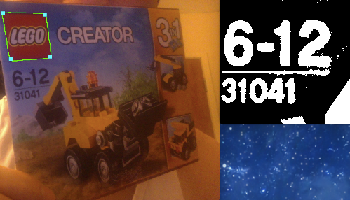
Image Preprocessing-denoise
Black and White Mask

Slide 29
Optical Number Recognition
Generate the training set
Three features – Original image, Canny image, Gradient image
Train the classifier – KNN, SVM, Random Forest
Pick the result
Pick the 5 numbers out

Slide 30



Training data
There are around 1000 samples for each number
Each number was reshaped to 16*16
Doing Canny and HOG(for the gradient) for each reshaped image
Turn the outputs to a 1*256 array.
Then we got the Training set, around 3000 samples for each number

Slide 31


Training set example

Slide 32

Classifier
KNN
SVM
Random Forest

Slide 33




Some Results

Slide 34




Some Results

Slide 35

CNN Training dataset
5 boxes,
each has 6 sides
300-400 pictures per boxes, totally 1600, under different conditions
Testing dataset also
created as 100-200 pictures per box, totally 600.

Slide 36
Convolutional Neuron Network
30*30
28*28*32
14*14*32
12*12*32
6*6*32
512
256
128
64
5
Input
Convolution1
by 3*3
Maxpool
subsampling
by 2*2
Convolution2
by 3*3
Maxpool
subsampling
by 2*2
Fully
Connecting
Neurons

Slide 37

CNN Model Training
Validation accuracy reach 0.83
after 16 epochs.
The best training model we used
have:
Training Loss: 0.08
Training accuracy: 0.96
(1600 training samples)
Testing Loss: 0.17
Testing accuracy: 0.95
(600 testing samples)

Slide 38



Convolution Layer results
Convolution 1
with 32 3*3 filters
RELU activation Layer
with 0.5 dropout
Max pool
with 2*2 filter size

Slide 39
External Library Used
Opencv 3.0
for image preprocessing
Keras 1.0.3 (based on theano)
for CNN model implementation
h5py 2.6.0
for CNN model written and read
Levenshtein 0.12.0
for computing string edit distances and similarities.

Slide 40
Conclusion
Although the algorithm we developed now can be light-invariant and pose-invariant, there are still many improvement can be done:
Accuracy on detection and recognition.
Fit into mobile platform
By working through this project, we really learned a lot.
Image processing, like thresholding, HSV color space, heat function
KNN, SVM, Random Forest in Optical Character Recognition
Convolutional Neuron Network
Team cooperating on Github

Slide 41
Live Demonstration
Thank you
Please feel free to ask any questions
You are welcome to fork our project at
https://github.com/sotondriver/Lego_classification

